Slide 1

Predicting the popularity of a song and clustering different genres together
Carlos Gonzalez

Slide 2
Objective
My first objective is to figure out if a certain song will be popular or not using predictive models. There is a multitude of reasons as to why this is important. In a commercial aspect, these types of models could be useful in predicting what songs would be the most profitable to advertise.
The second objective is to differentiate genres by the features given in the data set. The dataset contains various genres and with the different features I wanted to be able to cluster songs together that could be potentially given as a song recommendation. This was done through the k-means clustering algorithm.
Overall, I use this as an opportunity to learn more about the machine learning models covered in class and to handle preprocessing large amounts of data.

Slide 3
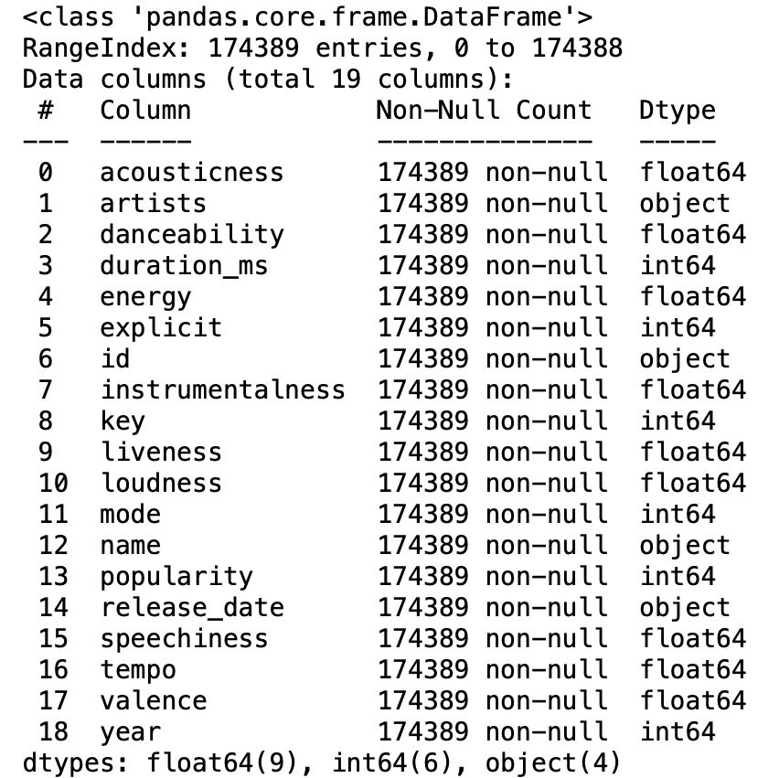
Spotify Dataset 1922-2021, ~600k Tracks
It contains various features of a song both in technical perspective such as tempo, key, loudness, and also historical records such as release date, popularity.
This dataset has 19 features. 5 categorical features and 15 numerical features.
Some are easy to tell what they are but others such as liveness that do not make much sense on their own.
Liveness is defined as the presence of an audience in the recording. A higher value equates to a higher probability of the song being played live.

Slide 4
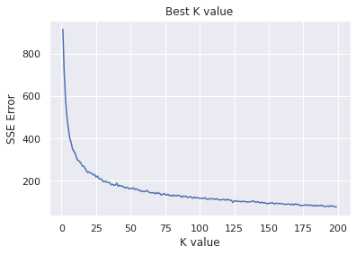
Selected models
Best Model for Popularity Prediction:
Decision Tree
Best Model for Differentiating Genres:
K-Means Clustering Algorithm
Compared to the K-Nearest Neighbor and Linear Regression model the Decision Tree turned out to be the best.
The decision tree was the best when a test size of 0.2, max_leaf_nodes = 178, and mincnt = 2.
This gave a RMSE(Root Mean Square Error) of 0.112.
For this part of my project I chose the K-Means Clustering Algorithm.
Using the Sum of Squared Error it was found that the best number of clusters is 25.
The purpose of this was to be able to create clusters of genres to be able to recommend someone a type of genre. In this case 25 genres happened to give the best predictions.

Slide 5
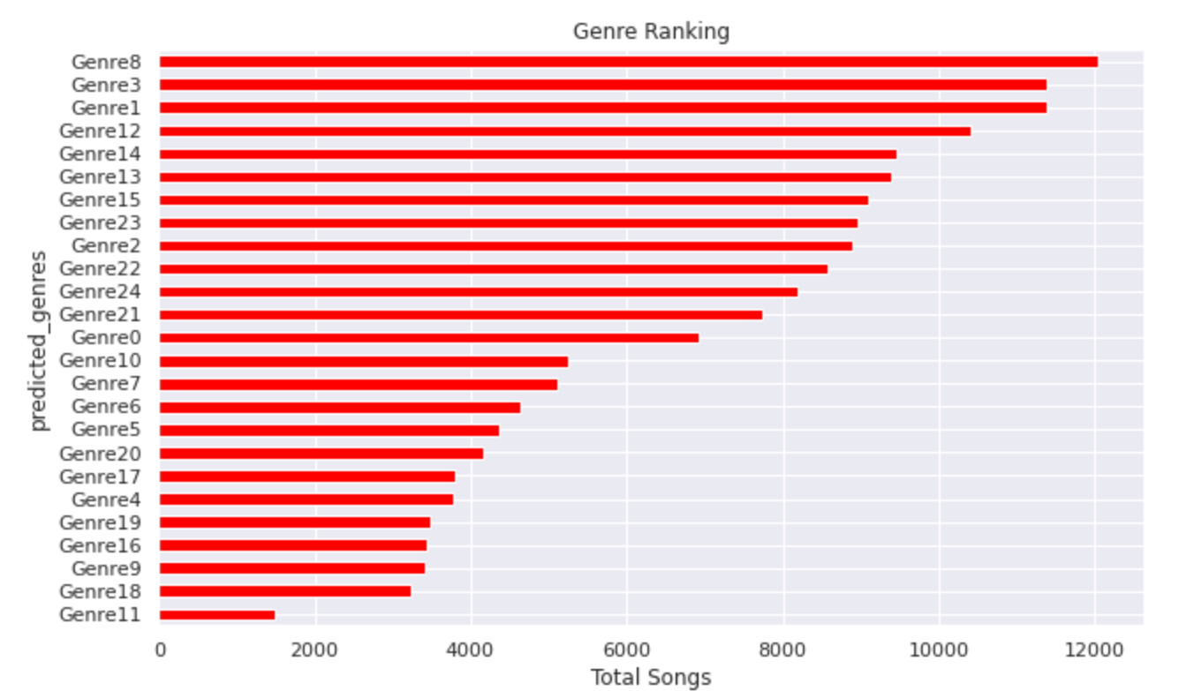
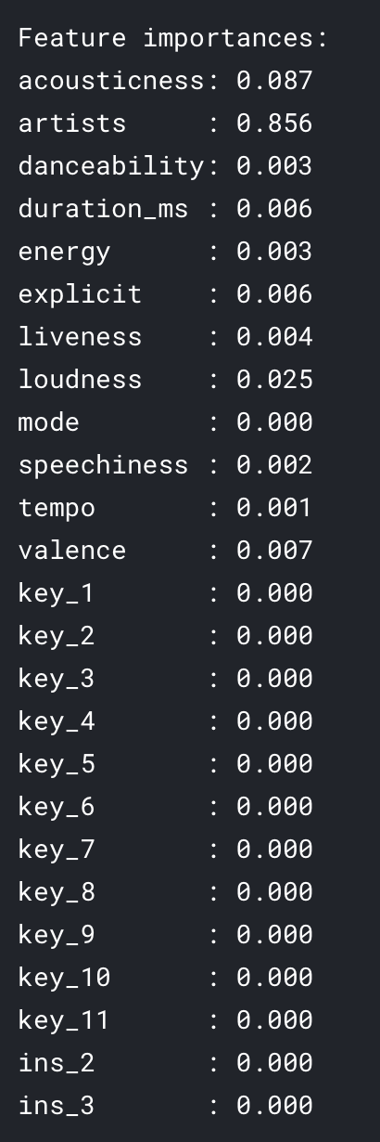

Results
For the first part of the project, we were able to see what parts of a song were the most important when it came to being able to predict what song was popular. Throughout the process, there was some type of indication of whether a feature had a negative or positive impact on its popularity. Of course, the data shown on the right side is considering a test size of .2, change the test size will give different results.
The second part of the project made me use the k-means algorithm to try and create genres based on the features of the song. The best way to figure out the best k was to try different k values and after various attempts, it was shown that the best value for k is 25. Then with this new list of genres, I was able to create a graph that showed roughly how many songs belonged to each genre.

